Slide 1

Introduction to Apache Spark
Open-Source Cluster Computing Framework

Slide 2
Apache Spark
Apache Spark is an open-source cluster computing framework. Its primary purpose is to handle the real-time generated data.
Built on Hadoop MapReduce system.
Optimized for in-memory processing.
Faster than traditional systems.
Ideal for big data and real-time needs.

Slide 3
Spark Origins
Developed at UC Berkeley, 2009.
Creators: Matei Zaharia, Ion Stoica, and Scott Shenker.
Lightning-fast analytics engine.
Unified for big data processing.
Ideal for machine learning tasks.

Slide 4
Issues with Hadoop
HDFS relies on frequent reads/writes.
Disk-based data processing is slow.
MapReduce lacks in-memory execution.
Inefficient for iterative workloads.
Limits real-time data processing.

Slide 5
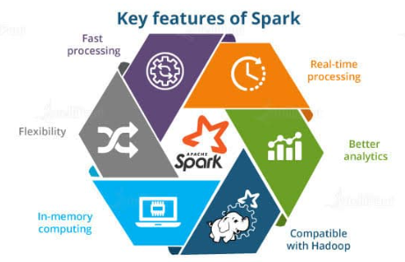
Key Features of Apache Spark
Speed: In-memory computation.
Ease: Simple APIs for users.
Flexibility: Diverse workloads.
Unified Engine: SQL, ML, streaming.
Compatibility

Slide 6
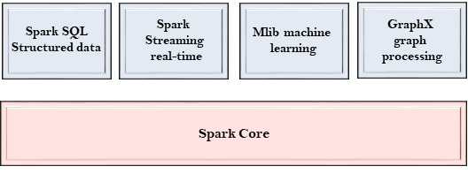
Apache Spark Components
Spark Core: Foundation for Spark.
Spark SQL: Structured data processing.
Spark Streaming: Real-time data streams.
MLlib: Tools for machine learning.
GraphX: Graph processing.

Slide 7

Spark SQL
Designed for structured data tasks.
Reads data from RDBMS tables.
Supports various file formats.
Enables seamless SQL queries.

Slide 8
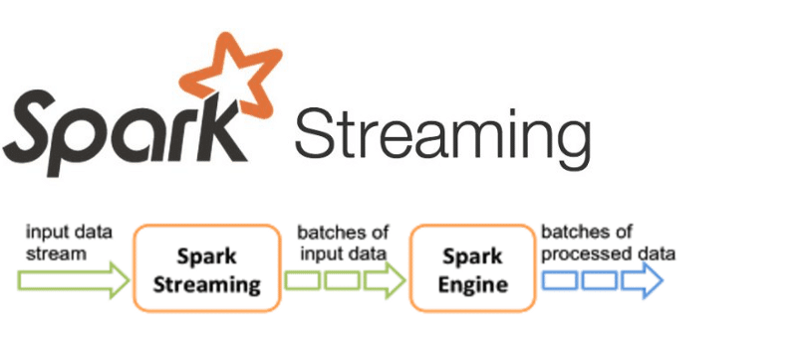
Spark Streaming
Built on Spark Core framework.
Performs real-time analytics.
Utilizes fast scheduling abilities.
Processes streaming data quickly.

Slide 9

Spark MLlib
Library for machine learning tasks.
Includes common ML algorithms.
Built into the Spark framework.
Optimized for distributed systems.

Slide 10
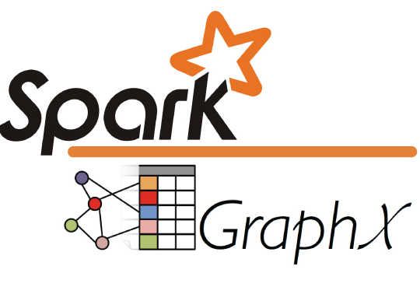
Spark GraphX
Library for graph manipulation.
Examples: social networks, routes.
Performs graph-parallel computations.
Handles network topology graphs.

Slide 11
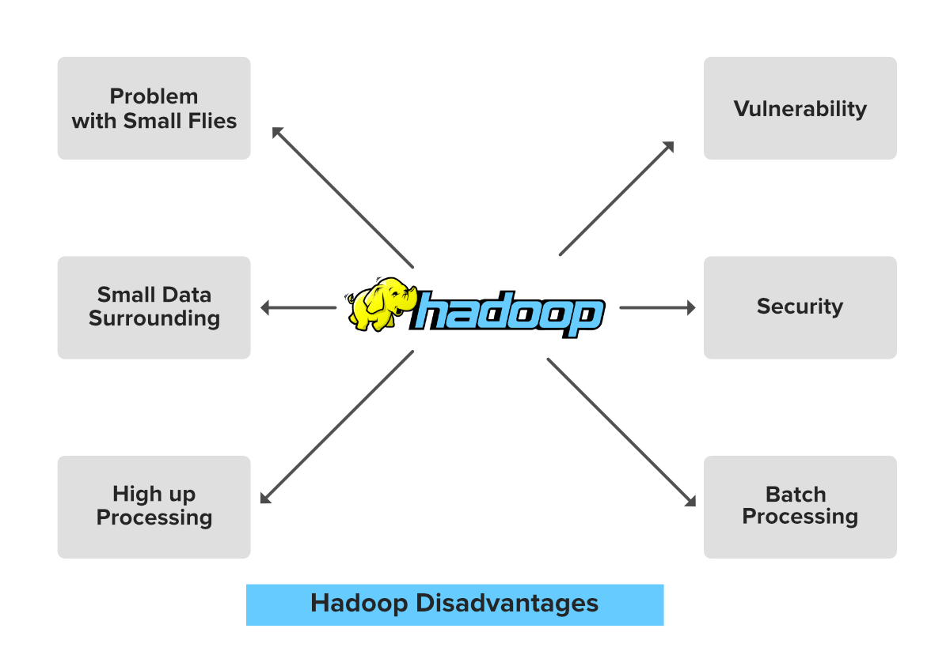
Limitations of Map Reduce
MapReduce is a programming model and framework, famously used in Apache Hadoop, for processing massive datasets in parallel across clusters of computers, making big data analysis scalable and efficient.
How it Works (The Two Phases)
Map Phase:
The input data (e.g., text files, logs) is broken into smaller chunks.
A "mapper" function processes each chunk, generating intermediate (key, value) pairs (e.g., (word, 1)).
Shuffle & Sort (Implicit):
The system automatically groups all intermediate values for the same key.
Reduce Phase:
A "reducer" function takes these grouped key-value pairs and performs an aggregation or summary (e.g., summing all the 1s for a given word to get the word count).

